Slide 1
Data Science Analytic Techniques
Thompson Forbes III, PhD, RN, Assistant Professor, East Carolina University College of Nursing

Slide 2
Objective
Understand the difference between traditional statistical and machine learning techniques for analyzing data.
Describe common data science and machine learning analytical methods.

Slide 3
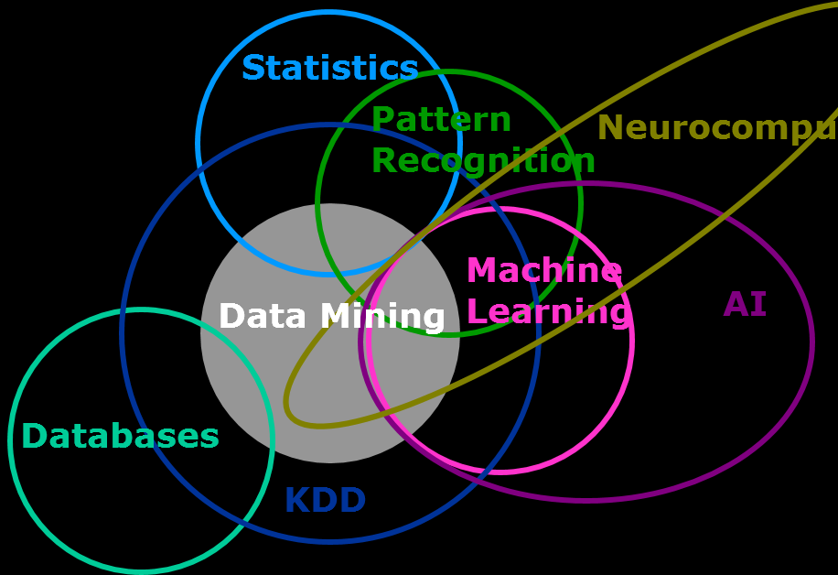
Commonalities
Not Mutually Exclusive
Both Approaches Seek to Learn “Something” from the Data

Slide 4
Defining Statistics and Machine Learning
Statistics – Focus on inference through creating and fitting of a project specific probability model.
Machine Learning – Prediction using general purpose learning algorithms to find patterns in rich and unwieldy data.
Bzdok, D. Statistics versus machine learning. Nature Methods, 15 (4)233-234.

Slide 5
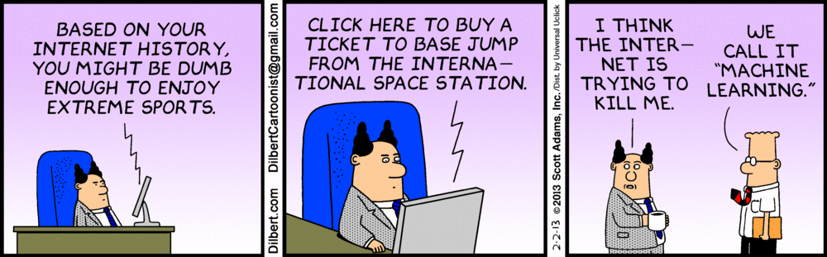

Slide 6
Terminology
Feature
Training
Classification
Overfitting
Supervised Learning
Unsupervised Learning

Slide 7
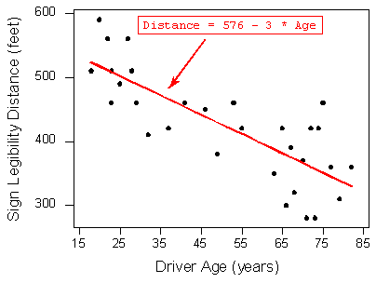
Regression
Linear Regression – Predicting an outcome based on the relationship between input variables (x) and output variables (y).

Slide 8
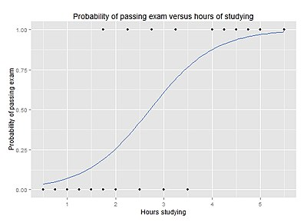
Regression
Logistic Regression – Predicting a categorical outcome based on the relationship between input variables (x) and categorical output variables (y).

Slide 9
Exemplar
Hertzog, M.A, Pozehl, B., & Duncan, K. (2010). Cluster analysis of symptom occurrence to identify subgroups of heart failure patients: A pilot study. Journal of Cardiovascular Nursing, 25(4), 273-283.
Purpose: To examine patient level factors associated with pressure ulcers.
Dataset: Military Nursing Outcomes Database (MilNOD); n=1653 patients
Results from Log Reg: Age, days in hospital, serum albumin, BUN, and mobility associated with presence of pressure ulcer.

Slide 10
Cluster Analysis
Grouping observations based on commonalities
Each group’s items must be similar to each other and different from other items in other groups.

Slide 11
Hierarchical Cluster Analysis
Each observation clusters into higher group and groups merge into higher groups.

Slide 12
K-Means Clustering
Single level partitioning into clusters.

Slide 13
Exemplar
Raju, D., Su, X., Patrician, P.A., Loan, L.A., & McCarthy M.S. (2015). Exploring factors associated with pressure ulcers: A data mining approach. International Journal of Nursing Studies, 52, 102-111. doi: 10.1016/j.ijnurstu.2014.08.002
Purpose: To identify subgroups of heart failure patients whose patterns of symptoms may help guide clinical management.
Dataset: Survey including demographics, clinical characteristics, and Kansas City Cardiomyopathy Questionnaire (KCCQ) n=139
Results: 3 cluster solution; C1-few symptoms, C2-many symptoms, C3-More symptoms than C1 & more swelling, bloating, dizziness than C2

Slide 15

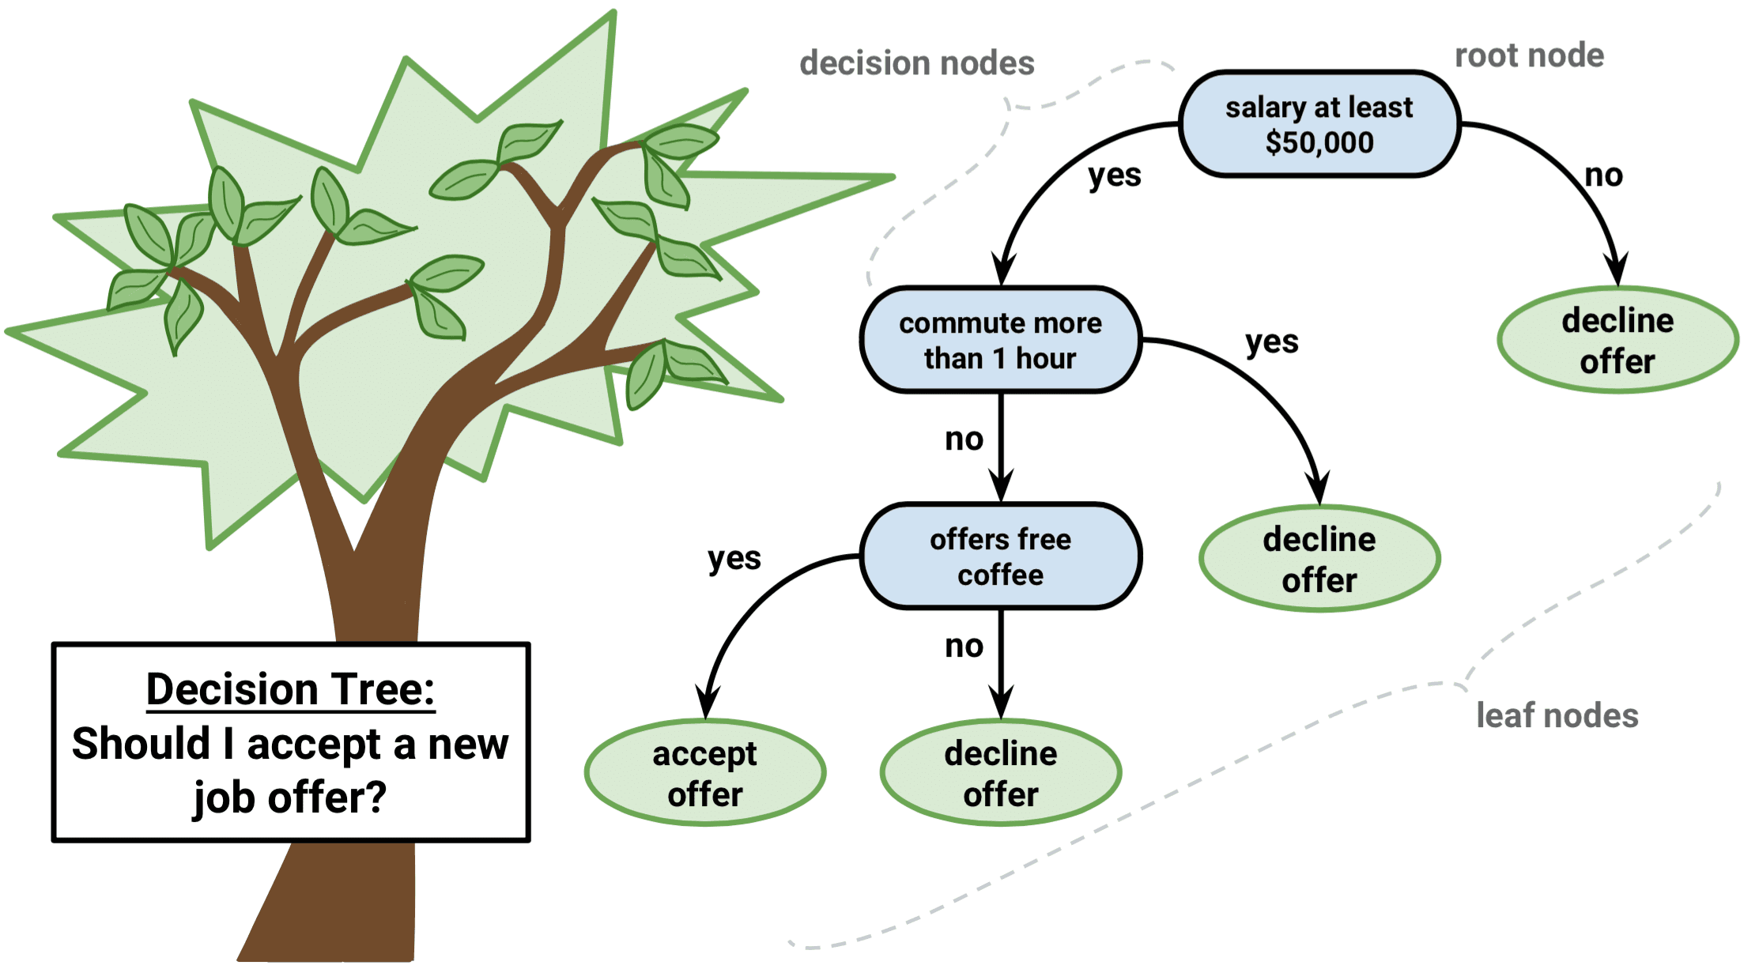
Decision Trees
Binary branching structure to classify an input.
Each comparison is either true or false
Non-linear and support categorical variables
At risk for overfitting

Slide 16
Exemplar
Kang, Y., McHugh, M.D., Chittams, J., & Bowles, K.H. (2016). Utilizing home healthcare electronic health records for telehomecare patients with heart failure. CIN: Computers, Informatics, Nursing, 34(4), 175-182.
Purpose: To detect associations with rehospitalizations among telehomecare patients with heart failure.
Dataset: OASIS-C dataset; n=552
Results: Presence of skin issues was top risk factor rehospitalization, followed by patient’s living situation, overall health status, severe pain experience, activity limiting pain, total number of anticipated therapy visits.

Slide 17
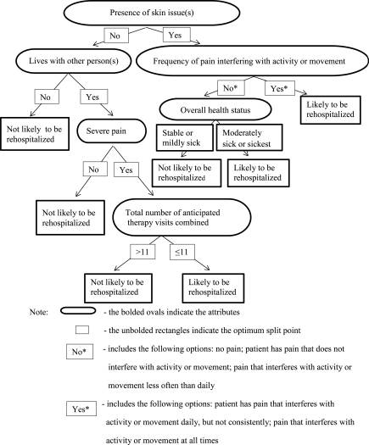

Slide 18


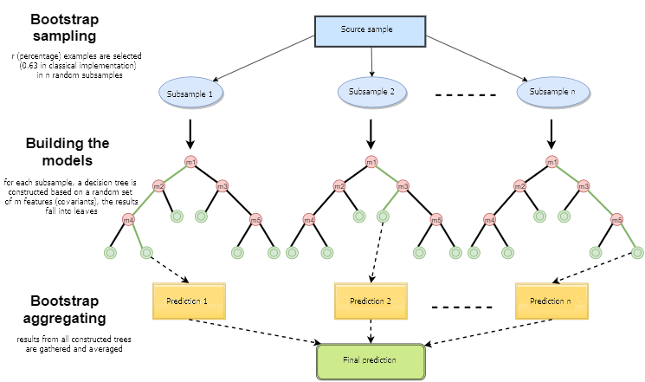
Random Forests
=
X
Supervised algorithm that builds multiple decision trees and merges them together
Used for classification and
regression problems.
Each tree is built off
random subset of data
with access to random
features.

Slide 19
Exemplar
Alderden, J., Pepper, G.A., Wilson, A., Whitney, J.D., Richardson, S., Butcher, R., Jo, Y., & Cummins, M.R. (2018). Predicting pressure injury in critical care patients: A machine learning model. American Journal of Critical Care, 27(6), 461-468. doi: 10.4037/ajcc2018525
Purpose: To develop a model for predicting development of pressure injuries among surgical critical care patients.
Dataset: EHR data from one hospital;n=7218-omitted 841=6376 records
Results: Developed RF model to predict stage 1 or > and stage 2 or > pressure injury. ROC 0.79 for both models.

Slide 20
Stage 1 or Greater Injury
Stage 2 or Greater Injury

Slide 21
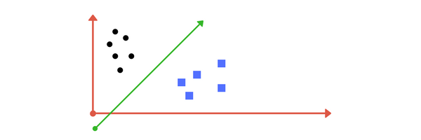
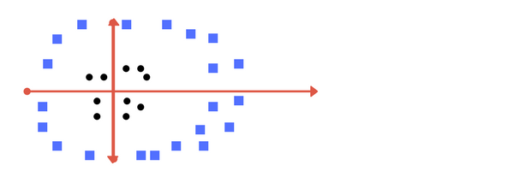
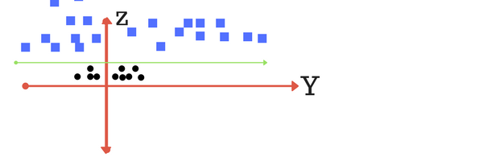
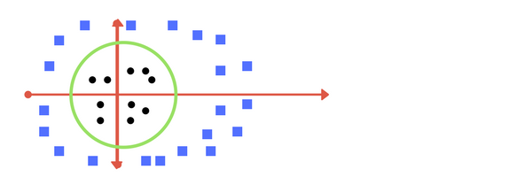

Support Vector Machines
Supervised learning algorithm that finds the hyper-plane that differentiates two classes.

Slide 22
Exemplar
Son, Y., Kim, H., Kim, E., Choi, S., & Lee, S. (2010). Application of support vector machine for prediction of medication adherence in heart failure patients. Healthcare Informatics Research, 16(4), 253-259. doi: 10.4258/hir.2010.16.4.253
Purpose: To identify predictors of medication adherence in HF patients.
Dataset: Self report questionnaire-demographics, medication knowledge, MMSE-K, EHR data, NYHA functional class. n=76
Results: 5 and 7 predictor models. Detection accuracy was 77.63%.

Slide 24
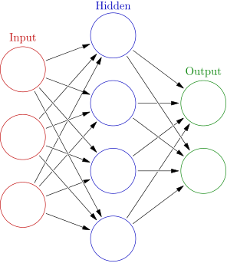
Neural Networks
Set of algorithms modeled after the human brain that are designed to recognize patterns.
Can be applied to images, sound, text or time series
Current Use in Healthcare
Diagnosis
Biochemical Analysis
Image Analysis
Drug Development
Notes:
Diagnostic systems – ANNs can be used to detect heart and cancer problems, as well as various other diseases informed by big data.
Biochemical analysis – ANNs are used to analyze urine and blood samples, as well as tracking glucose levels in diabetics, determining ion levels in fluids, and detecting various pathological conditions.
Image analysis – ANNs are frequently used to analyze medical images from various areas of healthcare, including tumor detection, x-ray classifications, and MRIs.
Drug development – Finally, ANNs are used in the development of drugs for various conditions – working by using large amounts of data to come to conclusions about treatment options.

Slide 25
Exemplar
Bagnasco, A., Siri, A., Aleo, G., Rocco, G., & Sasso, L. (2015). Applying artificial neural networks to predict communication risks in the emergency department. Journal of Advanced Nursing, 71(10), 2293-2304. doi: 10.1111/jan.12691
Purpose: To describe the utility of ANN in predicting nurse-patient communication risks .
Dataset: Observations of communication interactions of 840 nurses with patients during nursing activities. Questionnaire for personal/descriptive/level of training, Guilbert’s observation grid
Results: Variables likely to influence comm failure- terminology, listening, attention, clarity. ANN predicted performance of more than 80% of comm failures.

Slide 26
Guilbert’s Observation Grid on Comm Performance

